Slide 1

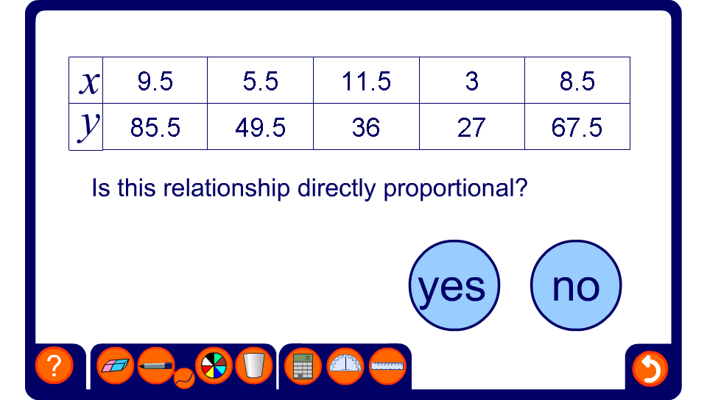


Checking for proportionality
Notes:
By finding the constant of proportionality or otherwise, ask pupils to determine whether the number in the table are in direct proportion.
If the values in the table are proportional ask pupils to write an equation to link them.

